Slide 1
Leveraging Knowledge Bases for Contextual Entity Exploration Categories
Date:2015/09/17
Author:Joonseok Lee, Ariel Fuxman, Bo Zhao, Yuanhua Lv
Source:KDD'15
Advisor:Jia-ling Koh
Spearker:LIN,CI-JIE

Slide 2
Outline
Introduction
Method
Experiment
Conclusion

Slide 3
Outline
Introduction
Method
Experiment
Conclusion

Slide 4
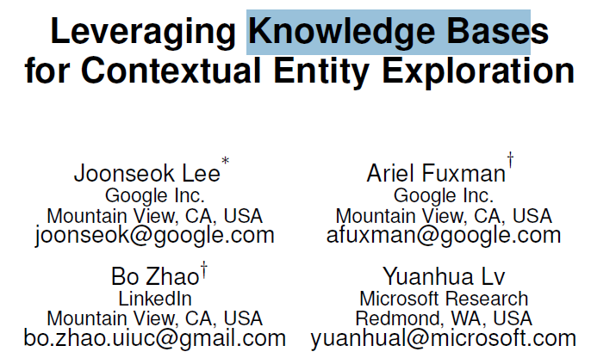
Introduction
Users are constantly switching back and forth from applications where they consume or create content to search engines where they satisfy their information needs

Slide 5
Introduction
Existing work in the literature that can be applied to this problem takes a standard bag-of-words information retrieval approach
syntactic match

Slide 6
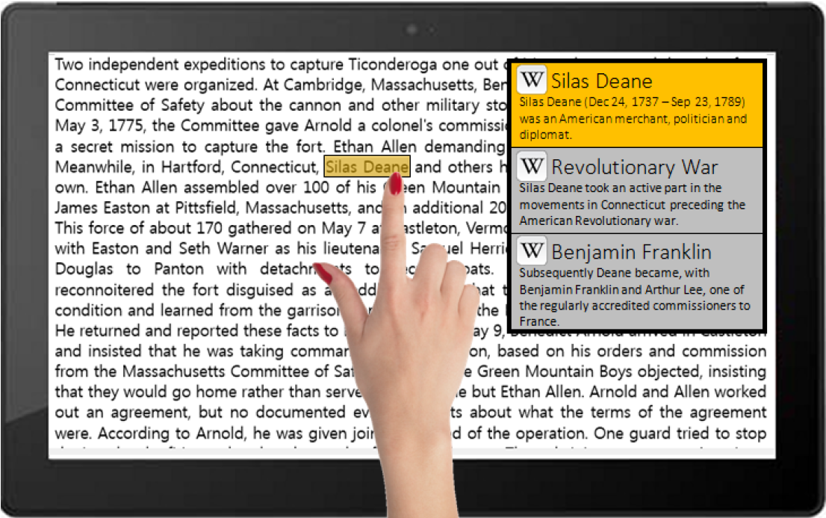
Introduction
Goal
Present a system called Lewis for retrieving contextually relevant entity results

Slide 7
Outline
Introduction
Method
Experiment
Conclusion

Slide 8
Flow char

Slide 9
Flow char

Slide 10
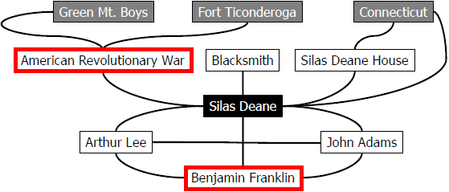
Focused Subgraph Construction
Mapping the user selection S and the context C to nodes in the knowledge graph
Any off-the-shelf entity linking system[9]

Slide 11
Focused Subgraph Construction
Black for the user selection node
Gray for context nodes
White is the set of entities reachable from nodes of user selection and context entities in the graph through a path of length one
Use the hyperlink structure of Wikipedia as the edges of the knowledge graph

Slide 12
Flow char

Slide 13
Context-Selection Betweenness
Captures to what extent a given candidate node serves as a bridge between the user selection node and the context nodes

Slide 14
Normalized Wikipedia Distance (NWD)
A measure of semantic distance of two nodes on graph
$I_{x}$ is the set of incoming edges to the node x
V is the set of all nodes in Wikipedia
NWD(Silas Deane,Green Mt. Boys)
=$\frac{\log\left(\max\left(7,1\right)\right)−log⁡(0)}{\log\left|V\right|−log(min(7,1))}\text{=}\frac{\log\left(7\right)−0}{\log\left|V\right|−log⁡(1)}$

Slide 15
Context-Selection Betweenness
sp(s,c) is a set of all shortest paths between s and c
$l(s,c)$ is the length of shortest path between user selection node s and context node c
k is the number of different shortest
paths between s and c

Slide 16
Context-Selection Betweenness
CSB(War) = $\frac{1}{Z}∗(\frac{w\left(Silas Deane,Green Mt. Boys\right)}{1∗l\left(Silas Deane,Green Mt. Boys\right)}+\frac{w\left(Silas Deane,Fort Ticonderoga\right)}{1∗l\left(Silas Deane,Fort Ticonderoga\right)})$

Slide 17
Flow char

Slide 18
Personalized Random Walk
The random walk[41] is simulating the behavior of a user reading articles

Slide 19
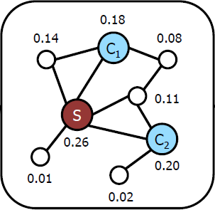
Personalized Random Walk
The random walk scores of a node are probability scores and thus sum up to 1
Personalized random walk retrieves semantically relevant pages from the query and context terms by assigning higher probability (score) to closely and densely connected nodes from the user selection and context nodes

Slide 20
Flow char

Slide 21
Score Aggregation
The expected value of RW(v) gets smaller when we have more nodes in the graph
consider |V|RW(v) instead of RW(v) itself, where V is the set of nodes in the focused graph
interpret this score as how many times the node is preferred to visit compared to expectation

Slide 22
Score Aggregation
The CSB(v) score for each node tends to be inversely proportional to the number of context nodes
consider |C|CSB(v) instead of CSB(v)
interpret |C|CSB(v) score as the expected number of shortest paths from user selection s to any context node visiting v in the meanwhile

Slide 23
Score Aggregation
Trust context-selection betweenness score more when we have more context terms
Trust context-selection betweenness less when we have a relatively large number of nodes in our focused graph compared to the number of context nodes

Slide 24
Score Aggregation
Recommend nodes v satisfying |V|RW(v) > 1 only
this is to remove some general terms
Recommend the top-k entities

Slide 25
Outline
Introduction
Method
Experiment
Conclusion

Slide 26
Dataset
English Wikipedia from January 2nd, 2014 as knowledge base
The corpus consists of 2,600 textbooks that cover a broad spectrum of topics, such as engineering, humanities, health sciences, and social sciences

Slide 27
Dataset
Sampled 900 paragraphs from this corpus, and for each paragraph we asked 100 crowd workers to select phrases for which they would like to learn more
Selected the top 8 results from our system as well as several baselines
For each result, we showed the original user selection and context to 10 crowd workers and ask them if they thought the recommended page is good in the context.

Slide 28
Dataset
Considered 100 words before and after the user selection as context for all compared methods
Used $X_{s}$ = 0.05, $X_{c}$ =0, $θ$ =0.5 and iterated up to 50 times for the personalized random walk

Slide 29
Results

Slide 30
Results

Slide 31
Outline
Introduction
Method
Experiment
Conclusion

Slide 32
Conclusion
Presented a framework for leveraging semantic signals from a knowledge graph for the problem of retrieving contextually relevant entity results
A large scale evaluation of the approach shows significant performance improvement with respect to state-of-the art methods for contextual entity exploration

Slide 33
Thanks for listening

Slide 34
REFERENCES
E. Yeh, D. Ramage, C. D. Manning, E. Agirre, and A. Soroa. Wikiwalk: Random walks on wikipedia for semantic relatedness. In Proc. of the Workshop on Graph-based Methods for Natural Language rocessing,2009

